Slide 1
Informed Search

Slide 2
Informed (Heuristic) Search Strategies
Informed Search – a strategy that uses problem-specific knowledge beyond the definition of the problem itself
Best-First Search – an algorithm in which a node is selected for expansion based on an evaluation function f(n)
  Traditionally the node with the lowest evaluation function is selected
  Not an accurate name…expanding the best node first would be a straight march to the goal.
  Choose the node that appears to be the best

Slide 3
Informed (Heuristic) Search Strategies
There is a whole family of Best-First Search algorithms with different evaluation functions
  Each has a heuristic function h(n)
h(n) = estimated cost of the cheapest path from node n to a goal node
Example: in route planning the estimate of the cost of the cheapest path might be the straight line distance between two cities
AI: Chapter 4: Informed Search and Exploration

Slide 4
A Quick Review
g(n) = cost from the initial state to the current state n
h(n) = estimated cost of the cheapest path from node n to a goal node
f(n) = evaluation function to select a node for expansion (usually the lowest cost node)
AI: Chapter 4: Informed Search and Exploration

Slide 5
Greedy Best-First Search
Greedy Best-First search tries to expand the node that is closest to the goal assuming it will lead to a solution quickly
  f(n) = h(n)
  aka “Greedy Search”
Implementation
  expand the “most desirable” node into the fringe queue
  sort the queue in decreasing order of desirability
Example: consider the straight-line distance heuristic h_{SLD}
  Expand the node that appears to be closest to the goal
AI: Chapter 4: Informed Search and Exploration

Slide 6
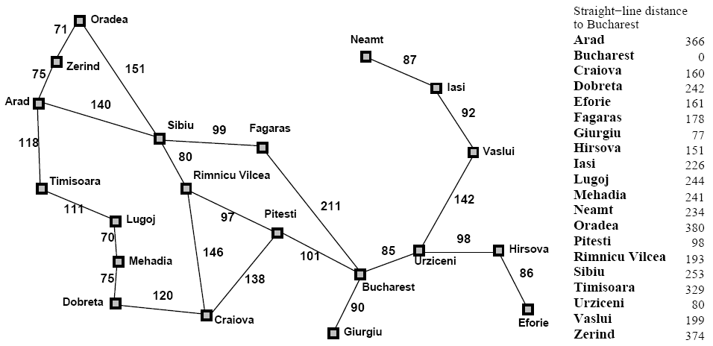
Greedy Best-First Search
AI: Chapter 4: Informed Search and Exploration

Slide 7
Greedy Best-First Search
h_{SLD}(In(Arid)) = 366
Notice that the values of h_{SLD} cannot be computed from the problem itself
It takes some experience to know that h_{SLD} is correlated with actual road distances
  Therefore a useful heuristic
AI: Chapter 4: Informed Search and Exploration

Slide 8

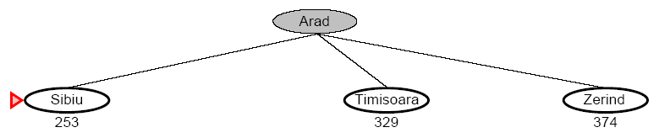
Greedy Best-First Search
AI: Chapter 4: Informed Search and Exploration

Slide 9
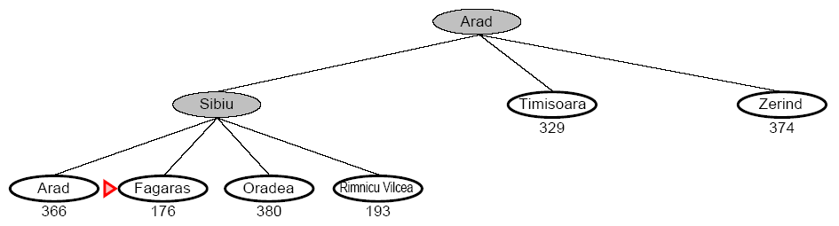
Greedy Best-First Search
AI: Chapter 4: Informed Search and Exploration

Slide 10
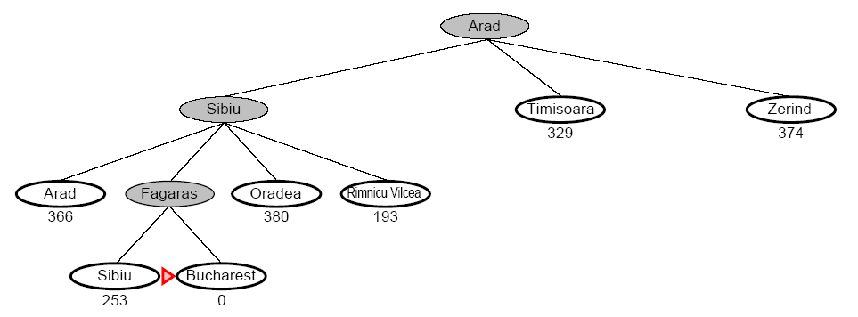
Greedy Best-First Search
AI: Chapter 4: Informed Search and Exploration

Slide 11
Greedy Best-First Search
Complete
  No, GBFS can get stuck in loops (e.g. bouncing back and forth between cities)
Time
  O(b^{m}) but a good heuristic can have dramatic improvement
Space
  O(b^{m}) – keeps all the nodes in memory
Optimal
  No!
AI: Chapter 4: Informed Search and Exploration

Slide 12
A Quick Review - Again
g(n) = cost from the initial state to the current state n
h(n) = estimated cost of the cheapest path from node n to a goal node (MUST USE AN ADMISSIBLE HEURISTICS)
f(n) = evaluation function to select a node for expansion (usually the lowest cost node)
AI: Chapter 4: Informed Search and Exploration

Slide 13
A* Search
A* (A star) is the most widely known form of Best-First search
  It evaluates nodes by combining g(n) and h(n)
  f(n) = g(n) + h(n)
  Where
    g(n) = cost so far to reach n
    h(n) = estimated cost to goal from n
    f(n) = estimated total cost of path through n
AI: Chapter 4: Informed Search and Exploration

Slide 14
A* Search
When h(n) = actual cost to goal
  Only nodes in the correct path are expanded
  Optimal solution is found
When h(n) < actual cost to goal
  Additional nodes are expanded
  Optimal solution is found
When h(n) > actual cost to goal
  Optimal solution can be overlooked
AI: Chapter 4: Informed Search and Exploration

Slide 15
A* Search
A* is optimal if it uses an admissible heuristic
  h(n) <= h*(n) the true cost from node n
  if h(n) never overestimates the cost to reach the goal (think of it as a kipta estimation which estimates equal or below the true cost)
Example
  h_{SLD} never overestimates the actual road distance
AI: Chapter 4: Informed Search and Exploration

Slide 16
A* Search
AI: Chapter 4: Informed Search and Exploration

Slide 17

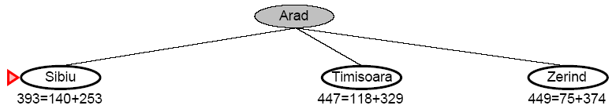
A* Search
AI: Chapter 4: Informed Search and Exploration

Slide 18
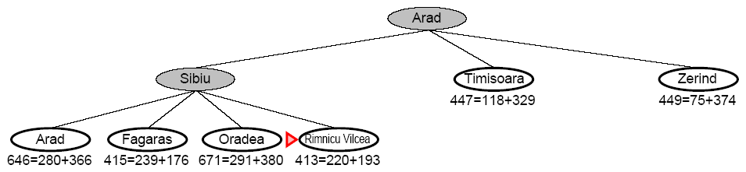
A* Search
AI: Chapter 4: Informed Search and Exploration

Slide 19
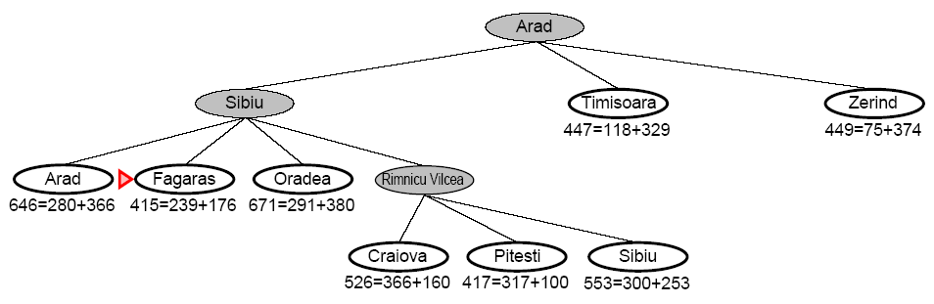
A* Search
AI: Chapter 4: Informed Search and Exploration

Slide 20
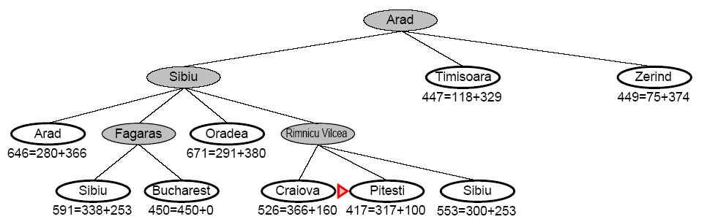
A* Search
AI: Chapter 4: Informed Search and Exploration

Slide 21
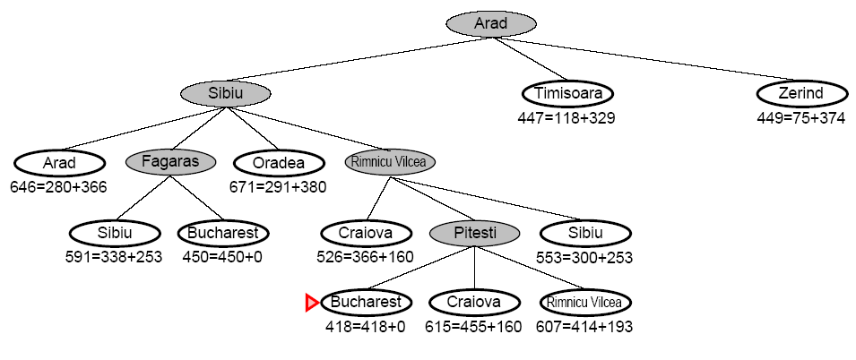
A* Search
AI: Chapter 4: Informed Search and Exploration

Slide 22
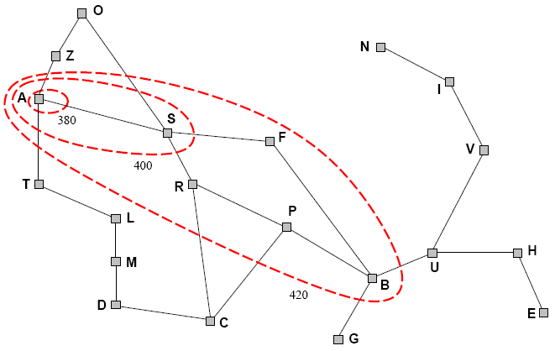
A* Search
A* expands nodes in increasing f value
  Gradually adds f-contours of nodes (like breadth-first search adding layers)
  Contour i has all nodes f=f_{i} where f_{i} < f_{i+1}
AI: Chapter 4: Informed Search and Exploration

Slide 23
A* Search
The closer an estimation of an A* heuristics is to the actual cost, the better it performs.
So, choose the maximum of the several heuristics
AI: Chapter 4: Informed Search and Exploration

Slide 24
A* Search
Complete
  Yes, unless there are infinitely many nodes with f <= f(G)
Time
  Exponential in [relative error of h x length of soln]
  The better the heuristic, the better the time
    Best case h is perfect, O(d)
    Worst case h = 0, O(b^{d}) same as BFS
Space
  Keeps all nodes in memory and save in case of repetition
  This is O(b^{d}) or worse
  A* usually runs out of space before it runs out of time
Optimal
  Yes, cannot expand f_{i+1} unless f_{i} is finished
AI: Chapter 4: Informed Search and Exploration

Slide 25
Memory-Bounded Heuristic Search
Iterative Deepening A* (IDA*)
  Similar to Iterative Deepening Search, but cut off is (g(n)+h(n)) instead of depth.
  At each iteration, cutoff is the first f-cost that exceeds the cost of the node at the previous iteration
RBFS – see figures 3.26 and 3.27
Simple Memory Bounded A* (SMA*)
  Set max to some memory bound
  If the memory is full, to add a node drop the worst (g+h) node that is already stored
  Expands newest best leaf, deletes oldest worst leaf
AI: Chapter 4: Informed Search and Exploration

Slide 26
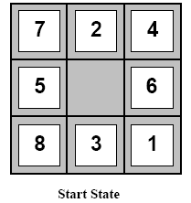
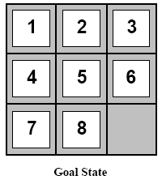
Heuristic Functions
Example: 8-Puzzle
  Average solution cost for a random puzzle is 22 moves
  Branching factor is about 3
    Empty tile in the middle -> four moves
    Empty tile on the edge -> three moves
    Empty tile in corner -> two moves
  3²² is approx 3.1e10
    Get rid of repeated states
    181440 distinct states
AI: Chapter 4: Informed Search and Exploration

Slide 27
Heuristic Functions
To use A* a heuristic function must be used that never overestimates the number of steps to the goal
h1=the number of misplaced tiles
h2=the sum of the Manhattan distances of the tiles from their goal positions
AI: Chapter 4: Informed Search and Exploration

Slide 28
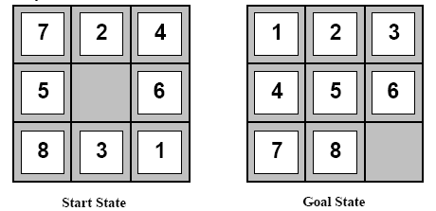
Heuristic Functions
h1 = 7
h2 = 4+0+3+3+1+0+2+1 = 14
AI: Chapter 4: Informed Search and Exploration

Slide 29
Dominance
If h2(n) > h1(n) for all n (both admissible) then h2(n) dominates h1(n) and is better for the search
Take a look at figure 3.29
AI: Chapter 4: Informed Search and Exploration

Slide 30
Relaxed Problems
A Relaxed Problem is a problem with fewer restrictions on the actions
  The cost of an optimal solution to a relaxed problem is an admissible heuristic for the original problem
Key point: The optimal solution of a relaxed problem is no greater than the optimal solution of the real problem
AI: Chapter 4: Informed Search and Exploration

Slide 31
Relaxed Problems
Example: 8-puzzle
  Consider only getting tiles 1, 2, 3, and 4 into place
  If the rules are relaxed such that a tile can move anywhere then h1(n) gives the shortest solution
  If the rules are relaxed such that a tile can move to any adjacent square then h2(n) gives the shortest solution
AI: Chapter 4: Informed Search and Exploration

Slide 32
Relaxed Problems
Store sub-problem solutions in a database
  # patterns is much smaller than the search space
  Generate database by working backwards from the solution
  If multiple sub-problems apply, take the max
  If multiple disjoint sub-problems apply, heuristics can be added
AI: Chapter 4: Informed Search and Exploration

Slide 33
Learning Heuristics From Experience
h(n) is an estimate cost of the solution beginning at state n
How can an agent construct such a function?
Experience!
  Have the agent solve many instances of the problem and store the actual cost of h(n) at some state n
  Learn from the features of a state that are relevant to the solution, rather than the state itself
    Generate “many” states with a given feature and determine the average distance
    Combine the information from multiple features
      h(n) = c(1)*x1(n) + c(2)*x2(n) + … where x1, x2, … are features
AI: Chapter 4: Informed Search and Exploration

